Slide 1

Introduction to Computer Systems
Fractions and Floating Point
Direct Link to view these slides on Google Docs

Slide 2
What to expect in this topic:
Conversion of Binary Fractions to Decimal
Conversion of Decimal fractions to Binary
Decimal and Binary floating point representation and operations (addition and multiplication)
Decimal and Binary floating point conversions

Slide 3
Fractions
How do we represent fractions in binary?
Could assume (binary) point at left end of bit string
0.b_{n-1}b_{n-2}...b₀
0.1110₂ = 1x 2⁻¹ + 1x 2⁻² +1x 2⁻⁴
= 0.5 + 0.25 + 0.125 + 0.0
= 0.875

Slide 4
Conversion of Binary Fractions to Decimal
To convert a binary fraction to decimal
Keep current value (initialised to 0) and current fraction (initialised to 0.5)
For each bit, from left to right, multiply current fraction by the bit, and add to current value
Halve current fraction as you move to next bit
Example 0.01101₂
Bit Value Fraction
0 0 0.5 <= 2⁻¹
1 0.25 0.25 <= 2⁻²
1 0.375 0.125 <= 2⁻³
0 0.375 0.0625 <= 2⁻⁴
1 0.40625 0.03125 <=2⁻⁵
Try practising with:
0.1011
0.0011
0.1001
0.1100

Slide 5
Conversion of Decimal Fractions to Binary
Conversion of decimal fractions to binary is easy!
Successively multiply fraction by 2
Integer part of result is next bit (0 or 1)
Discard this integer part and repeat
Example 0.345791
Fraction Doubled Bit
0.345791 0.691582 0
0.691582 1.383164 1
0.383164 0.796328 0
0.766328 1.532656 1
0.532565 1.065130 1
Result is 0.01011…. (most binary fractions will not terminate)
Try practising with:
0.875
0.910032
0.0225
0.36125
0.03125

Slide 6
Floating Point
Could assume (say) 64 bit numbers with binary point after 32 bits
Complex hardware needed, and restricted range of values (no more than with 32 bits of integers, you can’t exceed the range)
Use scientific notation?
Example1: 317.258
= 31.7258 × 10¹
= 3.17258 × 10²
= 0.317258 × 10³
= 0.0317258 × 10⁴
Example1: 0.005712
= 0.05712 × 10⁻¹
= 0.5712 × 10⁻²
= 5.712 × 10⁻³
= 57.12 × 10⁻⁴
Could store significand (Mantissa or Coefficient) and exponent separately
Mantissa is part of a number in scientific notation or a floating-point number, consisting of its significant digits.

Slide 7
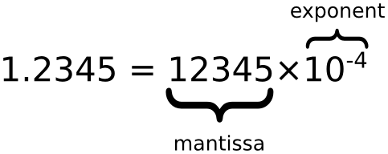
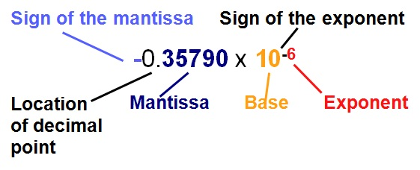
Floating Point

Slide 8
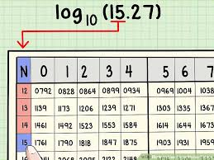
Decimal Floating Point
Before the days of electronic calculators, log tables were
used for arithmetic requiring similar evaluation of exponent
and significand. (Mantissa is a term used with log tables)
Store pair (S,E) representing Significand and
Exponent
Assume decimal point is one position from left
- 1 ≤ significand ≤ 9
- 5 digits in Mantissa (integer.fraction)
What is representation of
172.8392
M = 1.7283 E = 2
0.317485
M = 3.1748 E = -1
How do we do arithmetic?

Slide 9
Floating Point Operations - Decimal
Addition
What is 174.3846 + 0.9721
Assume 5 digits in Mantissa includes only 1 significand digit.
(1.7438,2) + (9.7210,-1)
Need exponents equal so shift significand (Mantissa) of smaller exponent and increase exponent
(1.7438,2) + (0.9721,0)
(1.7438,2) + (0.0972,1)
(1.7438,2) + (0.0097,2)
= (1.7535,2)
= 175.35

Slide 10
Floating Point Operations - Decimal
Addition
What is 978.39 + 59.992
(9.7839,2) + (5.9992,1)
(9.7839,2) + (0.5999,2)
(10.8338,2) => 6 digits (out of range)
Mantissa out of range, so shift left one position and increase exponent
= (1.0383,3)
Correcting the mantissa is Normalisation
Correcting in other direction might be needed after subtraction
Note loss of digits from significand(mantissa) – Rounding error

Slide 11
Floating Point Operations - Decimal
Multiplication
What is 172.83 × 0.039924
(1.7283,2) × (3.9924,-2)
Multiply the mantissas and add the exponents
(6.90006492,0)
Drop extra digits in mantissa
Normalisation might be needed
(5.3962,2) × (8.7144, -3) = (47.02464528, -1)
= (47.0246, -1)
= (4.7024,0)

Slide 12
Floating Point - Binary
Similar to decimal floating point, using powers of 2
Fixed format with fixed number of bits for exponent and significand (mantissa)
Range of numbers represented governed by number of bits for exponent
Accuracy governed by number of bits in significand(Mantissa)
Significand (Mantissa) usually normalised (leading bit 1)
New types of problem
Overflow – exponent too large for field
Underflow – exponent too large and negative for field
Rounding of significand (mantissa) rounding error

Slide 13
Floating Point Standardisation
Until 1990s different manufacturers floating point differed
Binary format – number of bits for significand and exponent
IBM actually used base 16 for exponent and normalisation
Rounding behaviour
1985 IEEE standardises floating point numbers
32 bit, 64 bit and 128 bit formats
Defined ranges for exponent and significand
Standard rounding behaviour and response to overflow or underflow

Slide 14
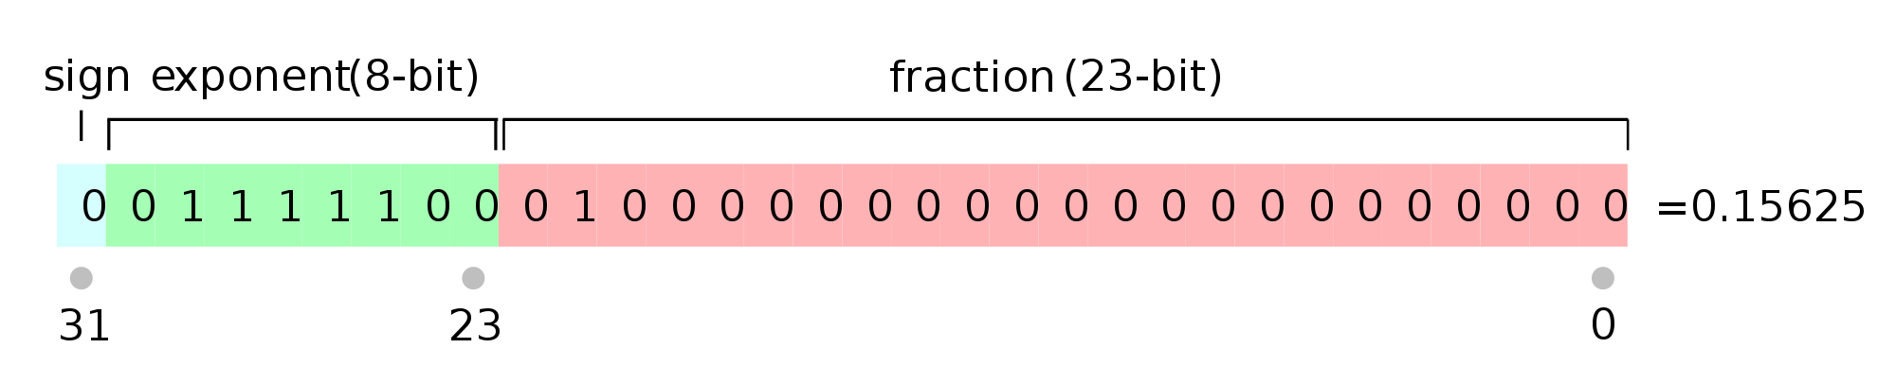
Floating Point Standardisation
32 bit words
Sign bit
8 bit exponent
23 bit fraction
Significand given by implicit 1 bit before fraction
Sign and magnitude representation for negative numbers
S e₇ e₆ e₅ e₄ e₃ e₂ e₁ e₀ f₁ f₂ … f₂₂ f₂₃
Exponent is in bias 127 format – bits e₇ e₆ e₅ e₄ e₃ e₂ e₁ e₀ represent the exponent with 127 added
Bits represent 130 – exponent is 3 => 130 - 127 = 3
Note: This floating point format is called 32-bit IEEE 754 single precision

Slide 15
Floating Point Decimal to Binary
What is floating point representation of 17.625 ?
Separate integer and fraction
17 ➔ 10001
0.625 ➔ 0.1010
Hence 17.625 ➔ 10001.101
Normalise to 1.0001 1010 with exponent 4 and sign bit 0
Add bias 127 to exponent 4 = 131 ➔ 1000 0011 (128+2+1=131)
Hence result is
0 1000 0011 0001 1010 0000 0000 0000 000
Exercise: Convert 24.0
128.25
0.07825
Floating Point Converter A neat little calculator that converts between decimal and IEEE floating point representation.

Slide 16
Floating Point Binary to Decimal
What is the decimal equivalent of
1 1000 0110 0101 1011 1100 0000 0000 000
Remove sign bit 1, so number is negative
Exponent 1000 0110 ➔ 134 so exponent is 7
Fraction is 1.0101 1011 1100 (remember implied 1 bit)
Hence value is 1 0101 101.1110
1010 1101 ➔ 128 + 32 + 8 + 4 + 1 ➔ 173
.1110 ➔ 0.875
-173.875

Slide 17
Floating Point Standardisation
Single-precision 32-bit IEEE 754 single precision floating point format is a computer number format, usually occupying 32 bits in computer memory, 8 bit exponent (bias 127) and 23 bit fraction.
Double precision floating point uses 64 bits, 11 bits of exponent (bias 1023) and 52 bits of fraction
– Gives 17 significant figure accuracy
Basically single precision floating point arithmetic deals with 32 bit floating point numbers whereas double precision deals with 64 bit.

